Slide 1
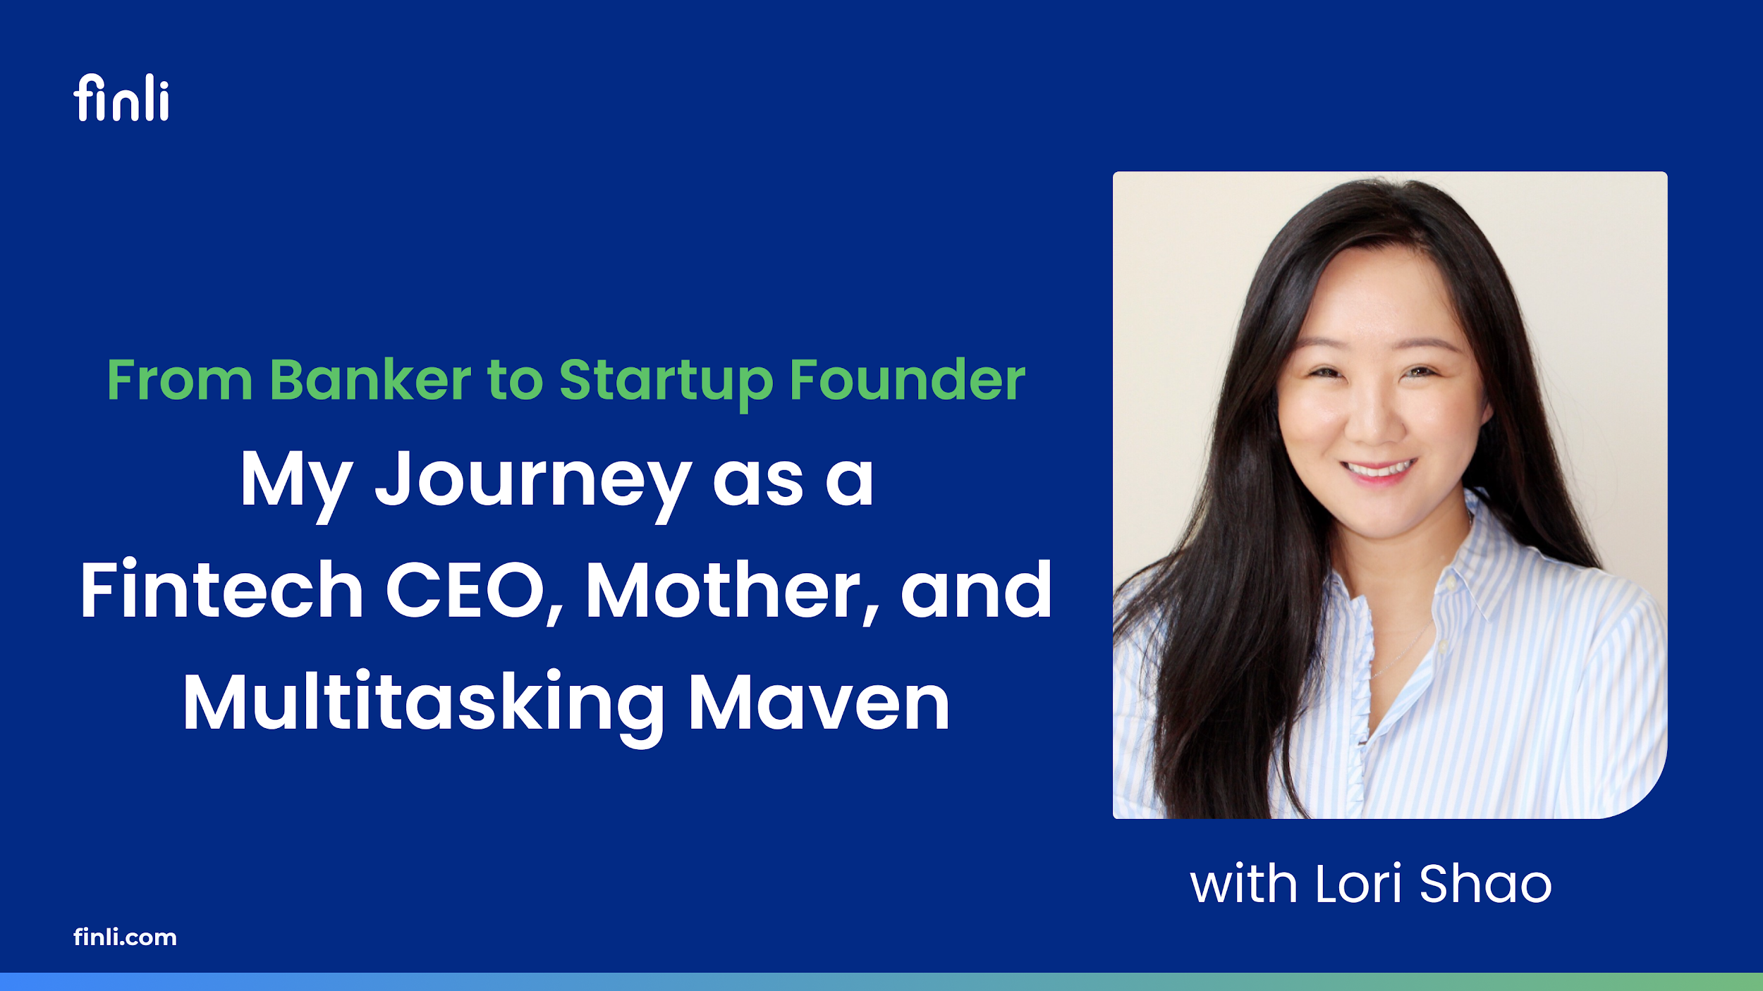
Notes:
Description:
Join me as I share my exhilarating journey from the traditional banking world to founding and leading a cutting-edge fintech startup. In this session, I will delve into the challenges and triumphs of navigating the financial sector, breaking through the glass ceiling, and transitioning to the innovative world of fintech.
Discover how I balance the demanding roles of a CEO, a dedicated mother, and a caretaker, all while prioritizing self-care. I will offer insights into the skills and strategies that have helped me wear multiple hats successfully, including time management, resilience, and the importance of a supportive network.
Whether you're looking to climb the corporate ladder, pivot to a new career, or find harmony between your professional and personal lives, this talk will provide you with inspiration and practical advice. Let's explore how to thrive in a high-stakes industry without sacrificing your well-being and personal fulfillment.

Slide 2


Slide 3


Slide 4


Slide 5


